Slide 1
Java Programming, 9e Chapter 2
Using Data

Slide 2
Objectives
Upon completion of this chapter you will be able to:
Declare and use constants and variables
Use integer data types
Use the boolean data type
Use floating-point data types
Use the char data type
Use the Scanner class to accept keyboard input
Use the JOptionPane class to accept GUI input
Perform arithmetic
Understand type conversion

Slide 3
Declaring and Using Constants and Variables (1 of 4)
Constant
Cannot be changed while program is running
Literal constant
Value taken literally at each use
Numeric constant
As opposed to a literal constant
Example: System.out.println(459)

Slide 4
Declaring and Using Constants and Variables (2 of 4)
Variable
A named memory location
Used to store a value
Can hold only one value at a time
Its value can change
Data type
A type of data that can be stored
How much memory an item occupies
What types of operations can be performed on data

Slide 5
Declaring and Using Constants and Variables (3 of 4)
Primitive type
A simple data type
Reference types
More complex data types

Slide 6
Declaring and Using Constants and Variables (4 of 4)
Table 2-1: Java primitive data types
Keyword | Description
byte | Byte-length integer
short | Short integer
int | Integer
long | Long integer
float | Single-precision floating point
double | Double-precision floating point
char | A single character
boolean | A Boolean value (true or false

Slide 7
Declaring Variables (1 of 3)
Name variables
Use naming rules for legal class identifiers
Variable declaration
A statement that reserves a named memory location
Includes:
Data type
Identifier
Optional assignment operator and assigned value
Ending semicolon

Slide 8
Declaring Variables (2 of 3)
Assignment operator
The equal sign (=)
The value to the right is assigned to the variable on the left
Initialization
An assignment made when declaring a variable
Assignment
An assignment made after a variable is declared
Associativity
The order in which operands are used with operators
Example: int bill=5;

Slide 9
Declaring Variables (3 of 3)
Declare multiple variables of the same type in separate statements on different lines
int myAge = 25;
int yourAge = 19;
When declaring variables of different types, you must use a separate statement for each type

Slide 10
Declaring Named Constants (1 of 2)
A named constant:
Should not change during program execution
Has a data type, name, and value
Has a data type preceded by the keyword final
Can be assigned a value only once
Conventionally is given identifiers using all uppercase letters
final int PI=3.14;

Slide 11
Declaring Named Constants (2 of 2)
Reasons for using named constants:
Make programs easier to read and understand
Enable you to change a value at one location within a program
Reduce typographical errors
Stand out as separate from variables

Slide 12
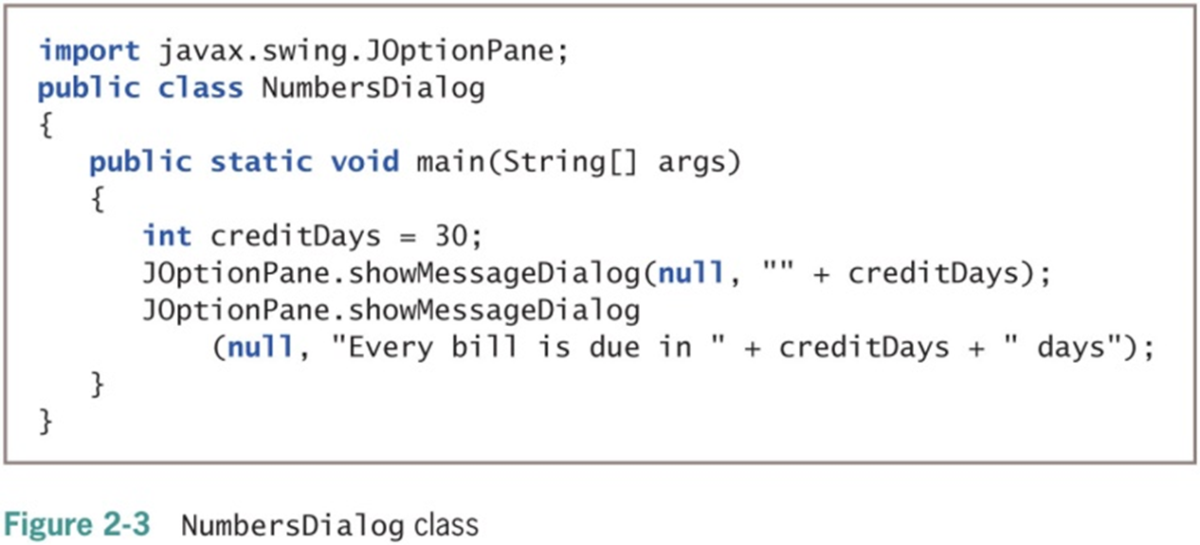
The Scope of Variables and Constants
Scope
The area in which a data item is visible to a program, and in which you can refer to it using its simple identifier
A variable or constant is in scope from the point it is declared
Until the end of the block of code where the declaration lies

Slide 13
Concatenating Strings to Variables and Constants (1 of 3)
print() or println() statement
Use alone or in combination with a String
Concatenated
A numeric variable is concatenated to a String using the plus sign
The entire expression becomes a String
The println() method can accept a number or String

Slide 14
Concatenating Strings to Variables and Constants (2 of 3)
Use a dialog box to display values
JOptionPane.showMessageDialog()
Does not accept a single numeric variable
Null String
An empty string: ""

Slide 15

Concatenating Strings to Variables and Constants (3 of 3)

Slide 16
Learning About Integer Data Types (1 of 2)
int data type
Stores an integer, or whole number
Value from –2,147,483,648 to +2,147,483,647
Variations of the integer type
byte
short
long
Choose appropriate types for variables

Slide 17
Learning About Integer Data Types (2 of 2)
Table 2-2: Limits on integer values by type
Type | Minimum Value | Maximum Value | Size in Bytes
byte | –128 | 127 | 1
short | –32,768 | 32,767 | 2
int | –2,147,483,648 | 2,147,483,647 | 4
long | –9,223,372,036,854,775,808 | 9,223,372,036,854,775,807 | 8

Slide 18
Using the boolean Data Type (1 of 2)
Boolean logic
Based on true-or-false comparisons
boolean variable
Can hold only one of two values
true or false
boolean isItPayday = false;
Relational operator (comparison operator)
Compares two items

Slide 19
Using the boolean Data Type (2 of 2)
Table 2-3: Relational operators
Operator | Description | True Example | False Example
< | Less than | 3 < 8 | 8 < 3
> | Greater than | 4 > 2 | 2 > 4
== | Equal to | 7 == 7 | 3 == 9
<= | Less than or equal to | 5 <= 5 | 8 <= 6
>= | Greater than or equal to | 7 >= 3 | 1 >= 2
!= | Not equal to | 5 != 6 | 3 != 3

Slide 20
Learning About Floating-Point Data Types (1 of 2)
Floating-point number
Contains decimal positions
Floating-point data types
float
double
Significant digits
Refers to mathematical accuracy

Slide 21
Learning About Floating-Point Data Types (2 of 2)
Table 2-4: Limits on floating-point values
Type | Minimum | Maximum | Size in Bytes
float | –3.4 * 10³⁸ | 3.4 * 10³⁸ | 4
double | –1.7 * 10³⁰⁸ | 1.7 * 10³⁰⁸ | 8

Slide 22
Using the char Data Type (1 of 3)
char data type
Holds any single character
Place constant character values within single quotation marks
char myMiddleInitial = 'M';
String
A built-in class
Stores and manipulates character strings
String constants are written between double quotation marks

Slide 23
Using the char Data Type (2 of 3)
Escape sequence
Begins with a backslash followed by a character
Represents a single nonprinting character
char aNewLine = '\n';
To produce console output on multiple lines in the command window, use one of these options:
Use the newline escape sequence
Use the println() method multiple times

Slide 24
Using the char Data Type (3 of 3)
Table 2-6: Common escape sequences
Escape Sequence | Description
\b | Backspace; moves the cursor one space to the left
\t | Tab; moves the cursor to the next tab stop
\n | Newline or linefeed; moves the cursor to the beginning of the next line
\r | Carriage return; moves the cursor to the beginning of the current line
\" | Double quotation mark; displays a double quotation mark
\’ | Single quotation mark; displays a single quotation mark
\\ | Backslash; displays a backslash character

Slide 25
Using the Scanner Class to Accept Keyboard Input (1 of 3)
System.in object
Standard input device
Normally the keyboard
Access using the Scanner class
Scanner object
Breaks input into units called tokens

Slide 26
Using the Scanner Class to Accept Keyboard Input (2 of 3)
Table 2-7: Selected Scanner class methods
Method | Description
nextDouble() | Retrieves input as a double
nextInt() | Retrieves input as an int
nextLine() | Retrieves the next line of data and returns it as a String
next() | Retrieves the next complete token as a String
nextShort() | Retrieves input as a short
nextByte() | Retrieves input as a byte
nextFloat() | Retrieves input as a float. Note that when you enter an input value that will be stored as a float, you do not type an F. The F is used only with constants coded within a program.
nextLong() | Retrieves input as a long. Note that when you enter an input value that will be stored as a long, you do not type an L. The L is used only with constants coded within a program.

Slide 27
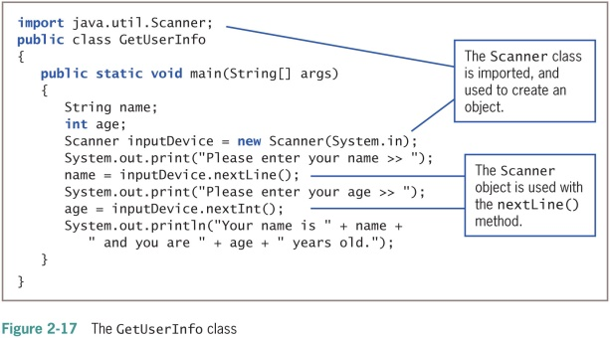
Using the Scanner Class to Accept Keyboard Input (3 of 3)

Slide 28
Pitfall: Using nextLine() Following One of the Other Scanner Input Methods
There is a problem when using one numeric Scanner class retrieval method or next()method before using the nextLine()method
Keyboard buffer
Location in memory that stores all keystrokes, including Enter
To avoid issues, add an extra nextLine()method call to retrieve the abandoned Enter key character after numeric or next() inputs

Slide 29
Using the JOptionPane Class to Accept GUI Input
Dialog boxes used to accept user input:
Input dialog box
Confirm dialog box

Slide 30
Using Input Dialog Boxes (1 of 5)
Input dialog box
Asks a question
Provides a text field in which the user can enter a response
showInputDialog() method
Six overloaded versions
Returns a String representing a user’s response
Prompt
A message requesting user input

Slide 31
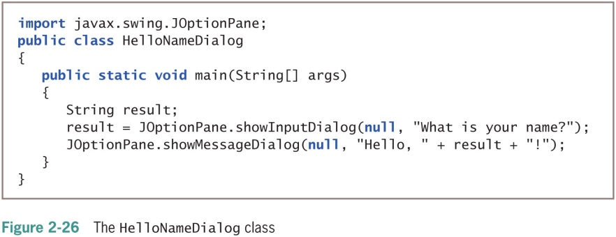
Using Input Dialog Boxes (2 of 5)

Slide 32
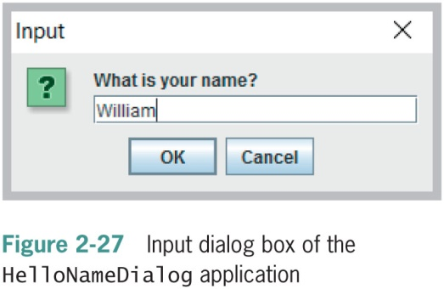
Using Input Dialog Boxes (3 of 5)

Slide 33
Using Input Dialog Boxes (4 of 5)
showInputDialog()
One version requires four arguments:
Parent component
Message
Title
Type of dialog box
Convert String to int or double
Use methods from the built-in Java classes Integer and Double

Slide 34
Using Input Dialog Boxes (5 of 5)
Type-wrapper classes
Each primitive type has a corresponding class contained in the java.lang package
Include methods to process primitive type values
Integer.parseInt()
Double.parseDouble()

Slide 35
Using Confirm Dialog Boxes (1 of 3)
Confirm dialog box
Displays the options Yes, No, and Cancel
showConfirmDialog() method in JOptionPane class
Four overloaded versions are available
Returns integer containing either:
JOptionPane.YES_OPTION
JOptionPane.NO_OPTION
JOptionPane.CANCEL_OPTION

Slide 36
Using Confirm Dialog Boxes (2 of 3)
You can create a confirm dialog box with five arguments:
Parent component
Prompt message
Title
Integer that indicates which option button to show
Integer that describes the kind of dialog box

Slide 37
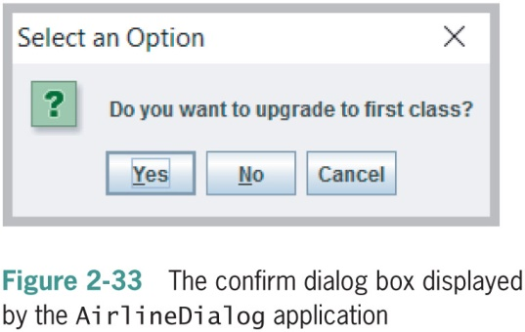
Using Confirm Dialog Boxes (3 of 3)

Slide 38
Performing Arithmetic Using Variables and Constants (1 of 2)
Standard arithmetic operators
Perform calculations with values in programs
Operand
A value used on either side of an operator
Integer division
Involves integer constants or integer variables
The result is an integer
Any fractional part of the result is lost

Slide 39
Performing Arithmetic Using Variables and Constants (2 of 2)
Table 2-8: Arithmetic operators
Operator | Description | Example
+ | Addition | 45 + 2, the result is 47
– | Subtraction | 45 – 2, the result is 43
* | Multiplication | 45 * 2, the result is 90
/ | Division | 45.0 / 2, the result is 22.5 45 / 2, the result is 22 (not 22.5)
% | Remainder (modulus) | 45 % 2, the result is 1 (that is, 45/2 = 22 with a remainder of 1)

Slide 40
Associativity and Precedence
Operator precedence
The rules for the order in which parts of mathematical expressions are evaluated
First multiplication, division, and remainder (modulus), then addition or subtraction

Slide 41
Writing Arithmetic Statements Efficiently
Avoid unnecessary repetition of arithmetic statements
Example of inefficient calculation:
stateWithholding = hours * rate * STATE_RATE;
federalWithholding = hours * rate * FED_RATE;
Example of efficient calculation:
grossPay = hours * rate;
stateWithholding = grossPay * STATE_RATE;
federalWithholding = grossPay * FED_RATE;

Slide 42
Understanding Type Conversion
Arithmetic with variables or constants of the same type
The result of arithmetic retains the same type
Arithmetic operations with operands of unlike types
Java chooses the unifying type for the result
Unifying type
The type to which all operands in an expression are converted for compatibility

Slide 43
Automatic Type Conversion
Automatically converts nonconforming operands to the unifying type
Order for establishing unifying types between two variables (highest to lowest):
double
float
long
int

Slide 44
Explicit Type Conversions
Type casting
Forces a value of one data type to be used as a value of another data type
Cast operator
Place desired result type in parentheses
Using a cast operator is an explicit conversion
You do not need to perform a cast when assigning a value to a higher unifying type
Example: double bankBalance = 189.66
float weeklybudget = (float) (bankBalance / 4)

Slide 45
Don’t Do It (1 of 2)
Don’t mispronounce integer
Don’t attempt to assign a literal constant floating-point number
Don’t forget precedence rules
Don’t forget that integer division results in an integer
Don’t attempt to assign a constant decimal value to an integer using a leading 0
Don’t use a single equal sign (=) in a Boolean comparison for equality
Don’t try to store a string of characters in a char variable

Slide 46
Don’t Do It (2 of 2)
Don’t forget that when a String and a numeric value are concatenated, the resulting expression is a string
Don’t forget to consume the Enter key after numeric input using the Scanner class when a nextLine()method call follows
Don’t forget to use the appropriate import statement when using the Scanner or JOptionPane class
Don’t forget precedence rules
Don’t forget that integer division results in an integer
Don’t forget that floating—point numbers are imprecise
Don’t use a single equal sign in a Boolean for comparison for equality

Slide 47
Summary (1 of 2)
Variables
Named memory locations
Primitive data types
Standard arithmetic operators for integers:
+, _, *, /, and %
Boolean type
true or false value
Relational operators:
>, <, ==, >=, <=, and !=

Slide 48
Summary (2 of 2)
Floating-point data types
float
double
char data type
Scanner class
Access keyboard input
JOptionPane
Confirm dialog box
Input dialog box

Slide 49
Exercise
Create a program that will satisfy the following specifications:
The program will compute the total wages of an employee. Specifically it will have the following requirements:
Accept the number of hours from the user.
Accept the hourly rate from the user
Accept the name of the employee
Compute the total wages
Display a message with the result
Challenge: Compute the overtime pay of the employee. If the hours is more than 40, the remaining hours are considered overtime. The overtime charge is 30% of the hourly rate.

